Slide 1
CSE 574 Lecture 15: Approximate Q-Learning and Policy Search
Professor: Stephanie Gil
Email: sgil@asu.edu (Office hours M 12-1pm BYENG 386)
TAs: Sushmita Bhattacharya sbhatt55@asu.edu (Office hours M 5-6 BYENG 392)
Weiying Wang wwang239@asu.edu (Office hours Th 2:30-3:30 BYENG 392)

Slide 2
Today
Approximate Q-Learning: what to do when your state space is too large?
Policy search

Slide 3
Last Time
Active reinforcement learning – learning a policy
Adaptive Dynamic Programming (ADP) – learning a model and then using this to learn a policy
Temporal Difference active learning – improving a policy each iteration
Assumes that you can sample the states and Q-states (state-action pairs) often enough

Slide 4
Evaluation Functions
Idea: summarize the value of a state (or state-action pair) by a function and use this function to estimate the value of a previously unvisited state
Why does this make sense?

Slide 5
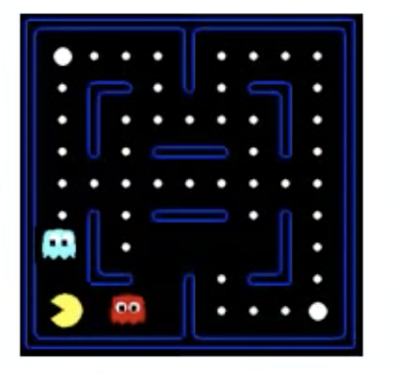
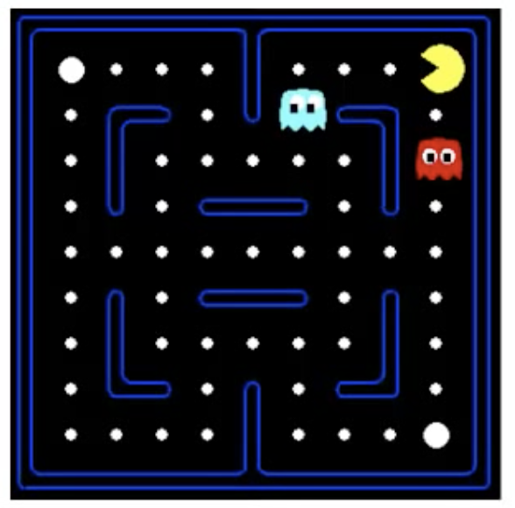
Example 1: Pacman
Possible features
Number of food pellets
Distance to ghosts
Number of ghosts

Slide 6
Example 2: Gridworld
Possible features
(x,y) coordinates
Distance from goal

Slide 7
Example 3: Chess
Possible features:
Number of each kind of piece on the board
Values of the pieces (i.e. pawn =1, bishop=3)
Move number
Number of remaining pieces

Slide 8
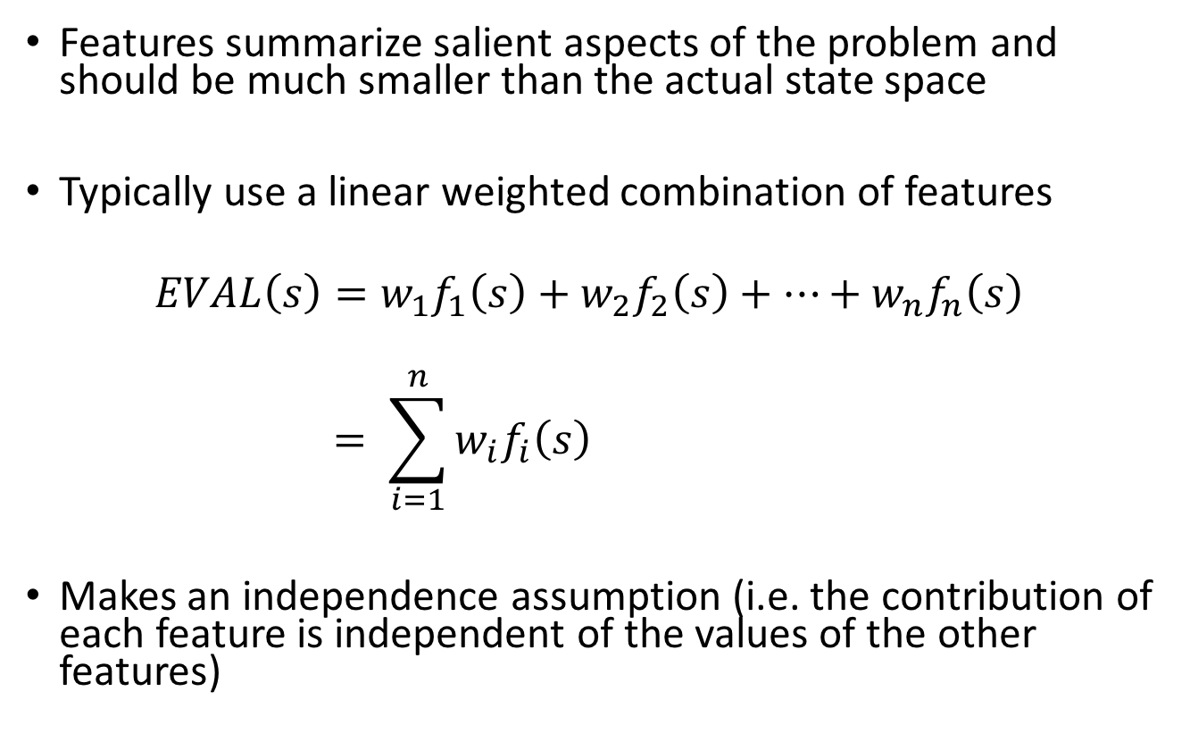
Features
Features summarize salient aspects of the problem and should be much smaller than the actual state space
Typically use a linear weighted combination of features
$$EVAL\left(s\right)=w_{1}f_{1}\left(s\right)+w_{2}f_{2}\left(s\right)+…+w_{n}f_{n}\left(s\right)$$
$$= \sum_{i=1}^{n}{w_{i}f_{i}\left(s\right) }$$
Makes an independence assumption (i.e. the contribution of each feature is independent of the values of the other features)

Slide 9
Feature-Based Representations
$$V\left(s\right)=w_{1}f_{1}\left(s\right)+w_{2}f_{2}\left(s\right)+…+w_{n}f_{n}(s)$$
Utility value
Q$\left(s,a\right)=w_{1}f_{1}\left(s,a\right)+w_{2}f_{2}\left(s,a\right)+…+w_{n}f_{n}(s,a)$
Q-value

Slide 10
Advantages of using Feature-Based Representation
The compression achieved by a function approximator allows the learning agent to generalize from states it has visited to states it has not visited
Example: by examining only one in every 10^12 possible backgammon states, it is possible to learn a utility function that allows a program to play as well as any human (Tesauro, 1992)

Slide 11
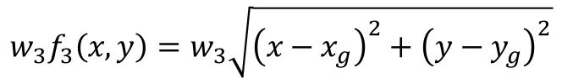
Notes on Linearity Assumption
Notice that the evaluation function is linear in weights and not features
Example approximation of a Q-value
Example feature for gridworld
$$Q\left(s,a\right)=w_{1}f_{1}\left(s,a\right)+w_{2}f_{2}\left(s,a\right)+…+w_{n}f_{n}\left(s,a\right)+w_{n+1}f_{n}^{2}(s,a)$$
$$w_{3}f_{3}\left(x,y\right)=w_{3}\sqrt{{\left(x−x_{g}\right)}^{2}+{\left(y−y_{g}\right)}^{2}}$$

Slide 12
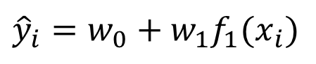
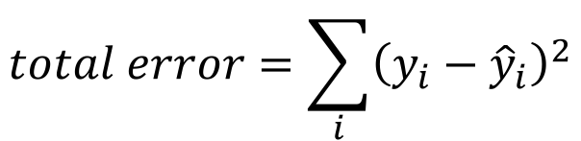
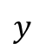
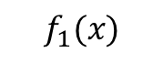

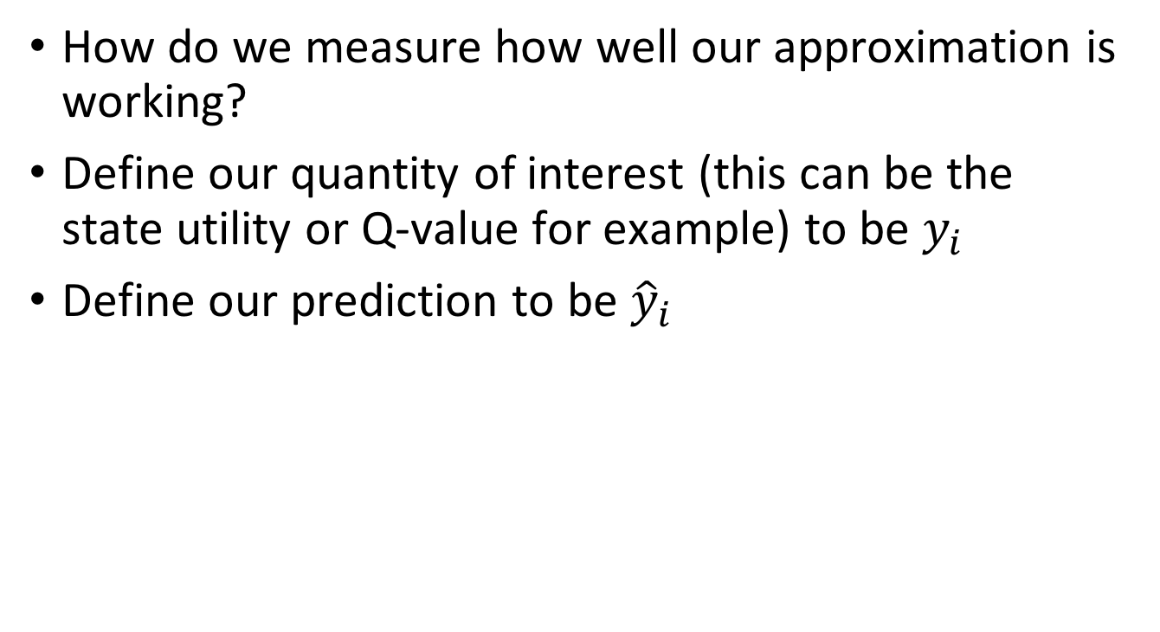
Error of Fit
How do we measure how well our approximation is working?
Define our quantity of interest (this can be the state utility or Q-value for example) to be $y_{i}$
Define our prediction to be ${\hat{y}}_{i}$
$${\hat{y}}_{i}$$
$${\hat{y}}_{i}=w_{0}+w_{1}f_{1}(x_{i})$$
$$y$$
error
$$total error=\sum_{i}{{\left(y_{i}−{\hat{y}}_{i}\right)}^{2}}$$
$$f_{1}(x)$$

Slide 13
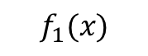
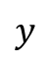
Tradeoff: Squared Error vs. Overfitting
Fit vs. ability to generalize
$${\hat{y}}_{i}$$
$$y$$
$$f_{1}(x)$$

Slide 14
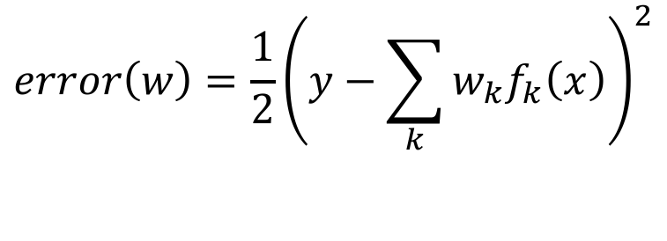
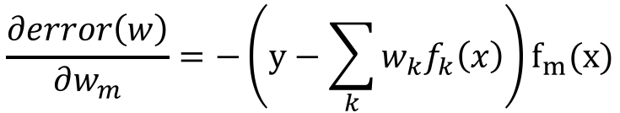
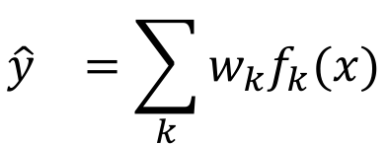
Updating Weights
Our goal is to choose weights (define the line) to improve fit
Example case: one point x with features f(x), target value y, and weights w
$${\hat{y}}_{}=\sum_{k}{w_{k}f_{k}(x)}$$
$$error\left(w\right)=\frac{1}{2}{\left(y−\sum_{k}{w_{k}f_{k}\left(x\right)}\right)}^{2}$$
$$\frac{∂error\left(w\right)}{∂w_{m}}=−\left(y−\sum_{k}{w_{k}f_{k}\left(x\right)}\right)f_{m}(x)$$

Slide 15
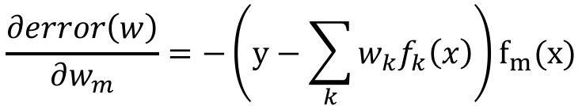
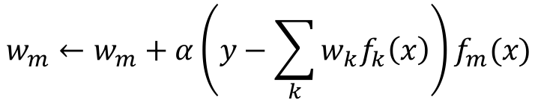
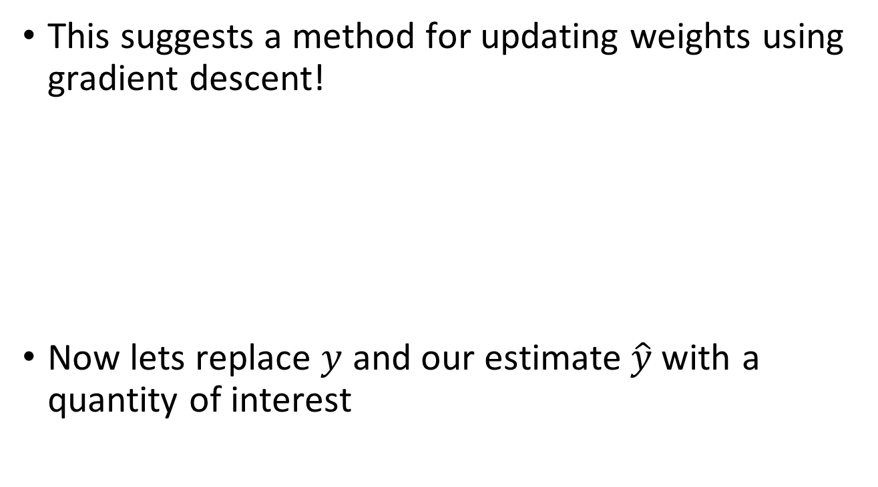
Updating Weights
This suggests a method for updating weights using gradient descent!
Now lets replace $y$ and our estimate$\hat{y}$with a quantity of interest
$$\frac{∂error\left(w\right)}{∂w_{m}}=−\left(y−\sum_{k}{w_{k}f_{k}\left(x\right)}\right)f_{m}(x)$$
$$w_{m}←w_{m}+α\left(y−\sum_{k}{w_{k}f_{k}\left(x\right)}\right)f_{m}(x)$$
$$w_{m}←w_{m}+α\left(r+γ\max_{a}{Q\left(s^{′},a^{′}\right)−Q\left(s,a\right)}\right)f_{m}(s,a)$$
Approximate Q-update
target
estimate

Slide 16
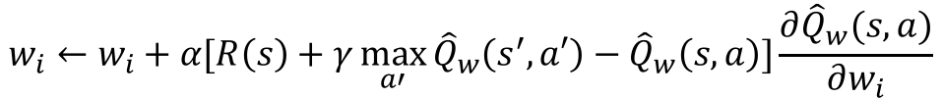
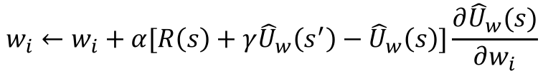
Equations for TD-Learners
Utilities
Q-values
$$w_{i}←w_{i}+α[R\left(s\right)+γ{\hat{U}}_{w}\left(s^{′}\right)−{\hat{U}}_{w}\left(s\right)]\frac{∂{\hat{U}}_{w}(s)}{∂w_{i}}$$
$$w_{i}←w_{i}+α[R\left(s\right)+γ\max_{a′}{{\hat{Q}}_{w}\left(s^{′},a′\right)−{\hat{Q}}_{w}\left(s,a\right)}]\frac{∂{\hat{Q}}_{w}(s,a)}{∂w_{i}}$$

Slide 17
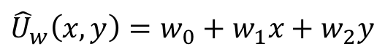
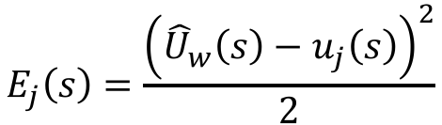
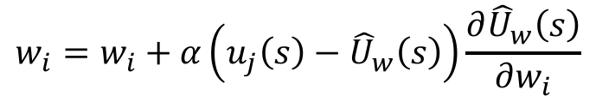
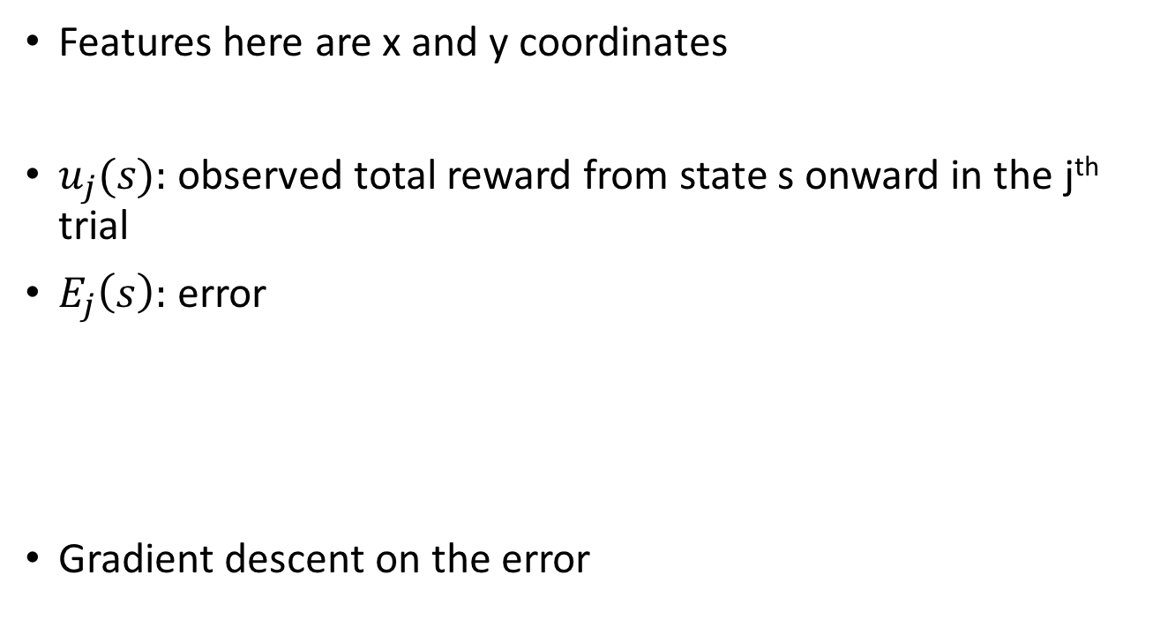
Example: Estimating Utilities for Gridworld
Features here are x and y coordinates
$u_{j}(s):$observed total reward from state s onward in the j^{th} trial
$E_{j}\left(s\right):$error
Gradient descent on the error
$${\hat{U}}_{w}\left(x,y\right)=w_{0}+w_{1}x+w_{2}y$$
Estimated utility
Observed utility
$$E_{j}\left(s\right)=\frac{{\left({\hat{U}}_{w}\left(s\right)−u_{j}\left(s\right)\right)}^{2}}{2}$$
$$w_{i}=w_{i}+α\left(u_{j}\left(s\right)−{\hat{U}}_{w}\left(s\right)\right)\frac{∂{\hat{U}}_{w}\left(s\right)}{∂w_{i}}$$

Slide 18
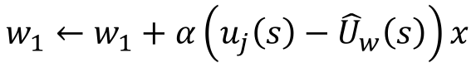
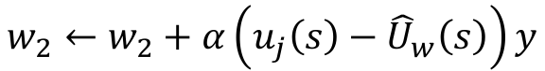
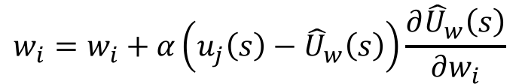
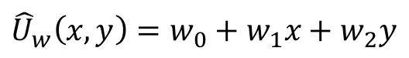
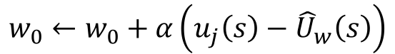
Example: Estimating Utilities for Gridworld
Recall gradient descent updates:
Update rules for our weights become
Calculate updated utility
$$w_{i}=w_{i}+α\left(u_{j}\left(s\right)−{\hat{U}}_{w}\left(s\right)\right)\frac{∂{\hat{U}}_{w}\left(s\right)}{∂w_{i}}$$
$$w_{0}←w_{0}+α\left(u_{j}\left(s\right)−{\hat{U}}_{w}\left(s\right)\right)$$
$$w_{1}←w_{1}+α\left(u_{j}\left(s\right)−{\hat{U}}_{w}\left(s\right)\right)x$$
$$w_{2}←w_{2}+α\left(u_{j}\left(s\right)−{\hat{U}}_{w}\left(s\right)\right)y$$
$${\hat{U}}_{w}\left(x,y\right)=w_{0}+w_{1}x+w_{2}y$$

Slide 19
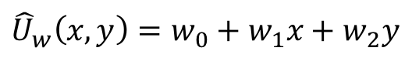
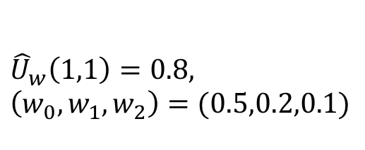
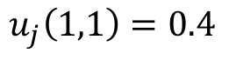
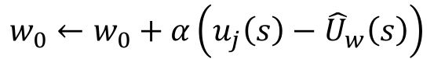
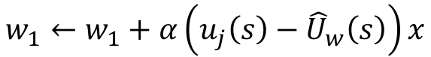
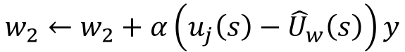
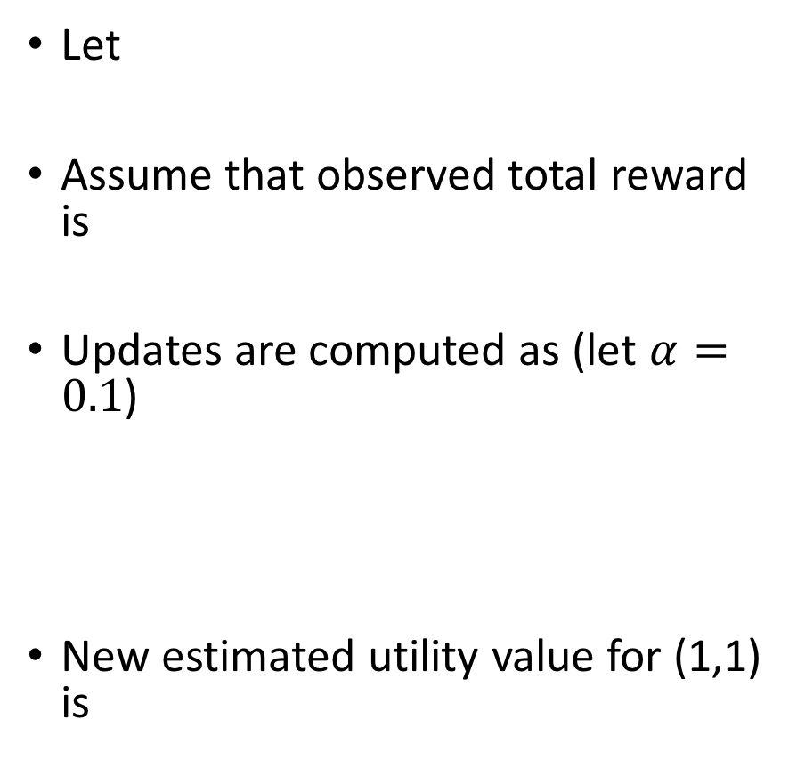
Example: Estimating Utilities for Gridworld
Let
Assume that observed total reward is
Updates are computed as (let $α=0.1$)
New estimated utility value for (1,1) is
$${\hat{U}}_{w}\left(1,1\right)=0.8,$$
$$\left(w_{0},w_{1},w_{2}\right)=(0.5,0.2,0.1)$$
$$u_{j}\left(1,1\right)=0.4$$
$$w_{0}←w_{0}+α\left(u_{j}\left(s\right)−{\hat{U}}_{w}\left(s\right)\right)$$
$$w_{1}←w_{1}+α\left(u_{j}\left(s\right)−{\hat{U}}_{w}\left(s\right)\right)x$$
$${\hat{U}}_{w}\left(x,y\right)=w_{0}+w_{1}x+w_{2}y$$
$$w_{2}←w_{2}+α\left(u_{j}\left(s\right)−{\hat{U}}_{w}\left(s\right)\right)y$$
${\hat{U}}_{w}\left(x,y\right)={(w}_{0}−α0.4)+{(w}_{1}−α0.4)∗1+{(w}_{2}−α0.4)∗1$ = 0.24

Slide 20
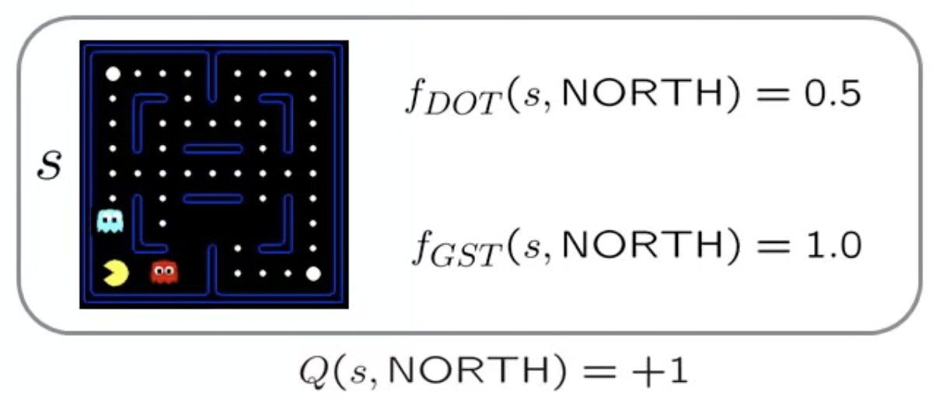
Example: Pacman
$$Q\left(s,a\right)=4f_{DOT}\left(s,a\right)−1.0f_{GST}(s,a)$$
Use features to approximate quantity of interest (Q-value)
food
distance to ghost
Compute action based on approximated Q-value
Observe new state and reward for that state
Adjust feature weights
Source: Berkeley CS 188 Lecture

Slide 21
Example: Pacman
$$Q\left(s,a\right)=4f_{DOT}\left(s,a\right)−1.0f_{GST}(s,a)$$
Use features to approximate quantity of interest (Q-value)
Compute action based on approximated Q-value
a= NORTH
Observe new state and reward for that state
Adjust feature weights
Source: Berkeley CS 188 Lecture

Slide 22
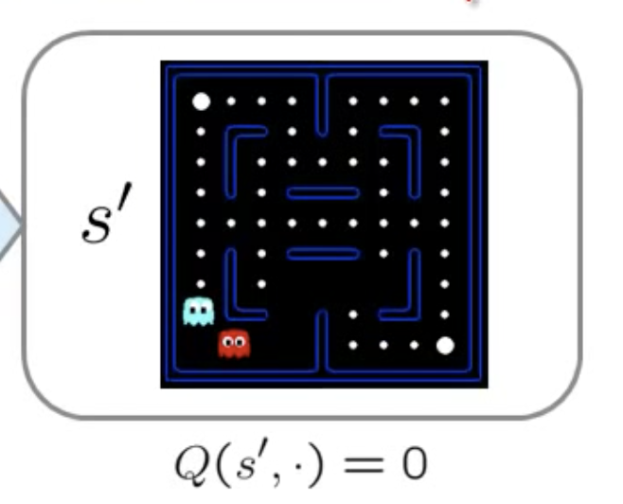
Example: Pacman
$$Q\left(s,a\right)=4f_{DOT}\left(s,a\right)−1.0f_{GST}(s,a)$$
Use features to approximate quantity of interest (Q-value)
Compute action based on approximated Q-value
a= NORTH
Observe new state and reward for that state
Adjust feature weights
r= -500
Source: Berkeley CS 188 Lecture 11

Slide 23
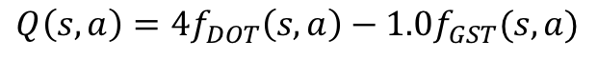
Example: Pacman
$$Q\left(s,a\right)=4f_{DOT}\left(s,a\right)−1.0f_{GST}(s,a)$$
Use features to approximate quantity of interest (Q-value)
a= NORTH
r= -500
Compute action based on approximated Q-value
$$w_{i}←w_{i}+α\left(r+γ\max_{a}{Q\left(s^{′},a^{′}\right)−Q\left(s,a\right)}\right)f_{i}(s,a)$$
= -500+0
(our sample)
=1
(current
estimate)
Observe new state and reward for that state
$$w_{DOT}←w_{DOT}+4.0+α\left[−501\right]0.5$$
$$w_{GST}←w_{GST}−1.0+α\left[−501\right]1.0$$
Adjust feature weights
Source: Berkeley CS 188 Lecture 11

Slide 24
Example: Pacman
$$Q\left(s,a\right)=4f_{DOT}\left(s,a\right)−1.0f_{GST}(s,a)$$
Use features to approximate quantity of interest (Q-value)
a= NORTH
r= -500
Compute action based on approximated Q-value
$$w_{i}←w_{i}+α\left(r+γ\max_{a}{Q\left(s^{′},a^{′}\right)−Q\left(s,a\right)}\right)f_{i}(s,a)$$
= -500+0
(our sample)
=1
(current
estimate)
Observe new state and reward for that state
$$w_{DOT}←w_{DOT}+4.0+α\left[−501\right]0.5$$
$$w_{GST}←w_{GST}−1.0+α\left[−501\right]1.0$$
Adjust feature weights
$$Q\left(s,a\right)=3.0f_{DOT}\left(s,a\right)−3.0f_{GST}(s,a)$$
Source: Berkeley CS 188 Lecture 11

Slide 25
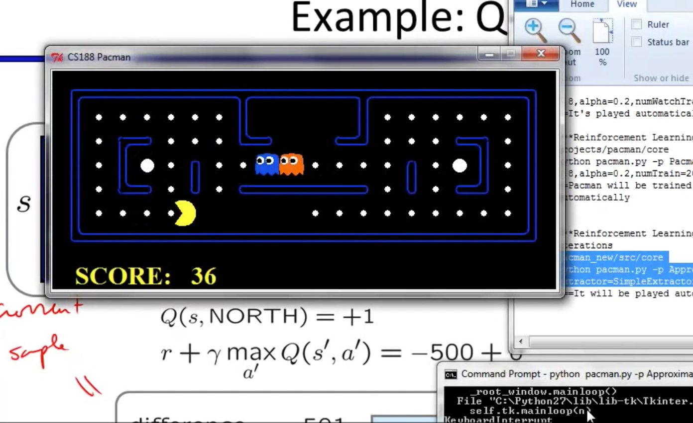
Pacman Example
Source: Berkeley CS 188 Lecture 11

Slide 26
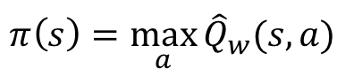
Policy Search
Use our estimated Q-values for state-action pairs to find the best policy
Not the same as Q-learning (we are not trying to estimate Q here)
Russell and Norvig text gives an example of a continuous policy representation
$$π\left(s\right)=\max_{a}{{\hat{Q}}_{w}(s,a)}$$

Slide 27
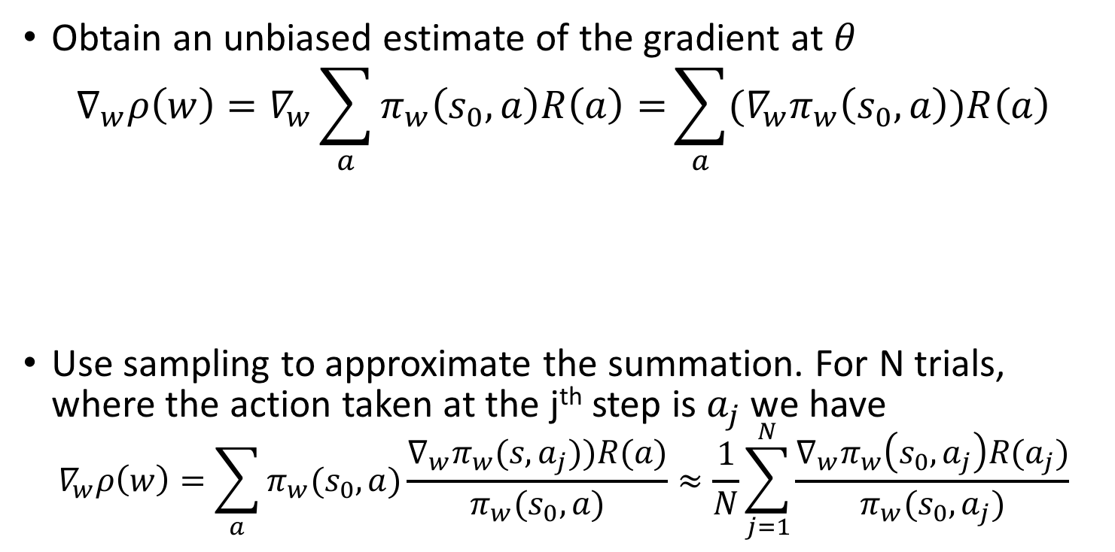
Policy Gradient
Obtain an unbiased estimate of the gradient at $θ$
$$∇_{w}ρ\left(w\right)=∇_{w}\sum_{a}{π_{w}\left(s_{0},a\right)R\left(a\right)=}\sum_{a}{(∇_{w}π_{w}\left(s_{0},a\right))R\left(a\right)}$$
Use sampling to approximate the summation. For N trials, where the action taken at the j^{th} step is$a_{j}$we have
$$∇_{w}ρ\left(w\right)=\sum_{a}{π_{w}(s_{0},a)\frac{∇_{w}π_{w}(s,a_{j}))R(a)}{π_{w}(s_{0},a)}}≈\frac{1}{N}\sum_{j=1}^{N}{\frac{∇_{w}π_{w}\left(s_{0},a_{j}\right)R(a_{j})}{π_{w}(s_{0},a_{j})}}$$
Policy gradient
Expected value of the reward

Slide 28
Next Time
Reinforcement learning recitation
Partially observable states
HMM
POMDPs

